Slide 1
Week 14
Our Response
Loving Others

Slide 2
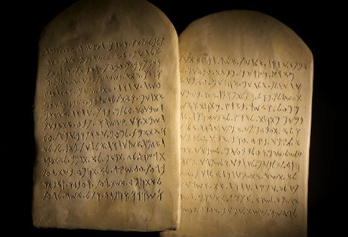
Pastor Cory’s 4 Rules to Healthy Dating
Don’t do anything you wouldn’t do in front of your grandmother.
When dating stay with a group.
When dating stay vertical.
When dating keep the lights on.

Slide 3
Closing Prayer

